Slide 1

Balanced Parentheses in Compiler Design Professional Presentation Compiler Syntax Analysis using Stack
SUPERVISOR:
Dr. J. Alphonsa
Presented By: M. A. Surya Kiran(192411236)

Slide 2


Problem Statement
Compiler reads program source code
Checks (), {}, and [] symbols
Every opening symbol requires a matching closing symbol
Improper nesting causes syntax errors
Validation occurs before code generation

Slide 3
Suitable Data Structure: Stack
Stack follows Last In, First Out (LIFO)
Push opening brackets onto the stack
Pop when matching closing bracket appears
Top element is compared for correctness
Empty stack at end indicates balanced parentheses

Slide 4
Working Algorithm
Scan expression from left to right
Push every opening bracket
Match and pop on closing bracket
Report error for mismatch or empty stack
Accept expression if stack becomes empty

Slide 5
Why Stack is Suitable
LIFO matches nested parenthesis structure
Provides fast push and pop operations
Simple and memory efficient
Detects missing or extra brackets easily
Widely used in compiler implementations

Slide 6
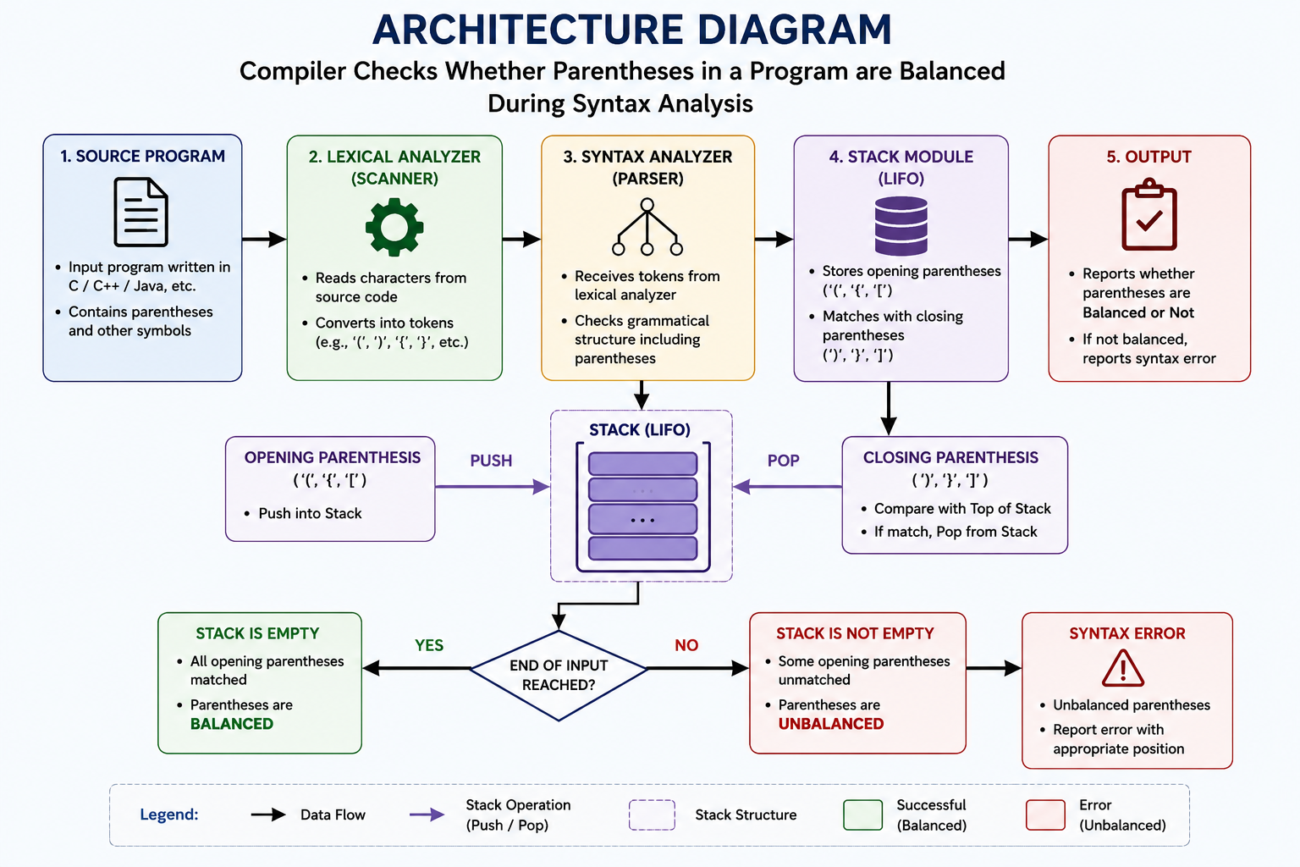
Architecture Diagram

Slide 7
Example Execution
Expression: {(a+b)*(c-d)}
Push '{' then '(' onto stack
Pop on ')' and later on '}'
All brackets matched successfully
Final stack is empty → Balanced

Slide 8
Advantages and Applications
Efficient with O(n) time complexity
Requires O(n) auxiliary space
Used in parsers and syntax analyzers
Supports nested expressions accurately
Improves compiler reliability

Slide 9
Conclusion
Stack is the ideal data structure
LIFO behavior simplifies matching process
Detects syntax errors effectively
Essential component of compiler design
Ensures correct program structure

